Slide 1
Multi-Period Optimal Power Flow (MP-OPF) for Power Distribution Systems with Renewables and Battery Storage
Team WSU
Aryan Ritwajeet Jha, Graduate Research Assistant¹
Dr. Subho Paul, Postdoctoral Research Associate¹
Dr. Anamika Dubey, Associate Professor¹
¹ Energy Systems Innovation Center, School of Electrical Engineering and Computer Science, Voiland College of Engineering, Washington State University, Pullman
Notes:
Remember to hit the reset button to make sure all the page elements react properly.
There are 20 different layouts that you can choose from.

Slide 2
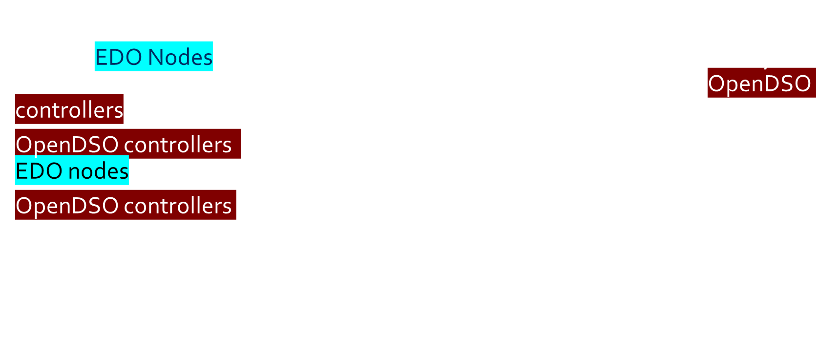
Overall Scope of the problem System Description and Objective
A radial distribution grid with multiple Grid Edge Resources.
Several EDO Nodes, which aggregate a portion of the Grid Edge Resources, and communicate and control them as per communication received from OpenDSO controllers.
OpenDSO controllers receive state variables from the grid, including those from EDO nodes, and load and DER generation forecast for the entire horizon.
OpenDSO controllers need to communicate amongst themselves (details in the algorithm).
The goal: To minimize some objective function $f(x)$, say line-losses or cost of substation power for the whole horizon of time-period $T$.
Controllable variables (example): ${q_{DER}^{t}}_{j}, B_{j}^{t}, P_{c_{j}}^{t}, P_{d_{j}}^{t}, q_{B_{j}}^{t}$

Slide 3
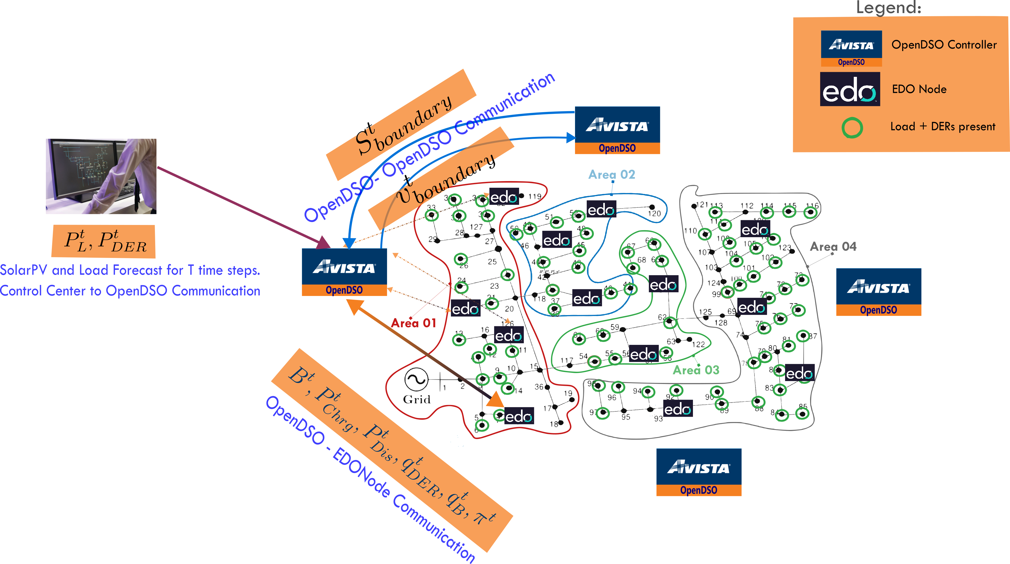
Overall Scope of the problem Algorithm and Communication Architecture
OpenDSO-System Operator (Forecast)
OpenDSO-Measurement Devices
OpenDSO-EDO
OpenDSO-OpenDSO

Slide 4
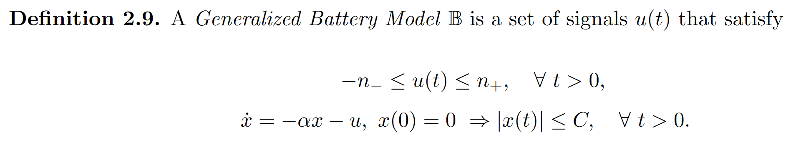
Nature of Aggregated Edo Nodes
Grid Edge Resources over multiple buildings aggregated to form Edo Nodes.
We model them as Batteries, which introduces temporal coupling between OPF solutions at individual time-steps.
This mandates MPOPF
Our model is based on the Generalized Battery Model as given in [2].
Exception 1: Lifetime dissipation is not modelled.
Exception 2: Currently limits such as charging/discharging limits are assumed to be constant over time (in one day).

Slide 5
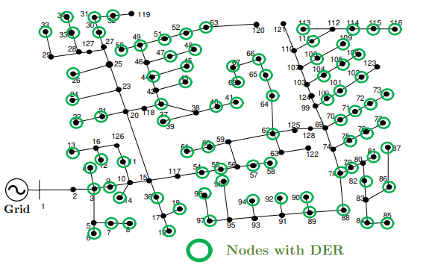
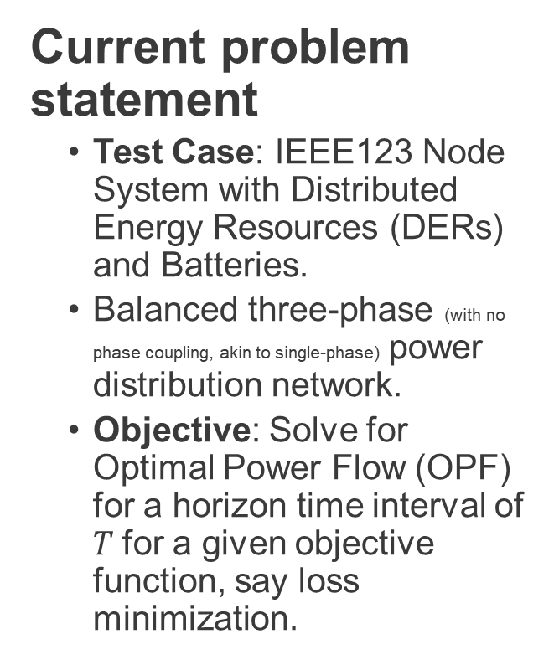
Network being tested on
Current problem statement
Test Case: IEEE123 Node System with Distributed Energy Resources (DERs) and Batteries.
Balanced three-phase (with no phase coupling, akin to single-phase) power distribution network.
Objective: Solve for Optimal Power Flow (OPF) for a horizon time interval of $T$for a given objective function, say loss minimization.

Slide 6
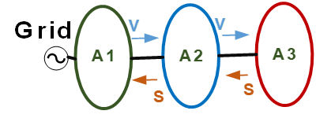
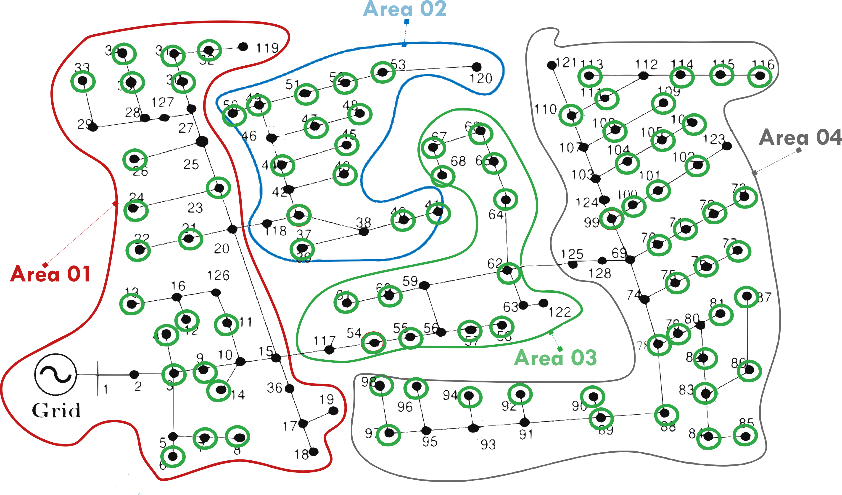

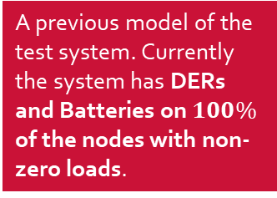
Network being tested on
A previous model of the test system. Currently the system has DERs and Batteries on $100\%$ of the nodes with non-zero loads.
ENApp Approach [1]
Divide the network into several areas to solve for their Optimal Power Flow solutions separately, with exchange of boundary variables after every ‘macro-iteration’.

Slide 7
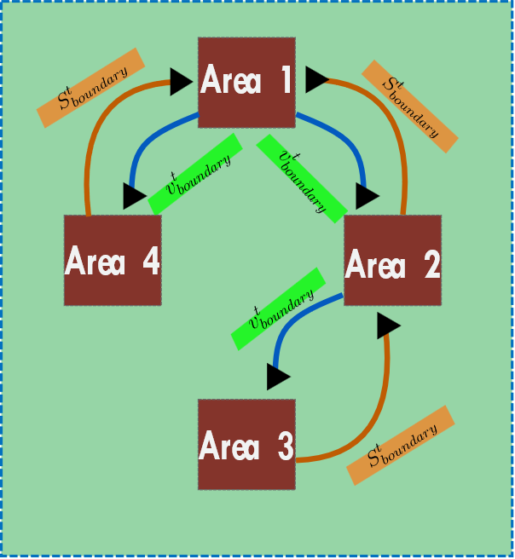
A simpler schematic for D-OPF.

Slide 8
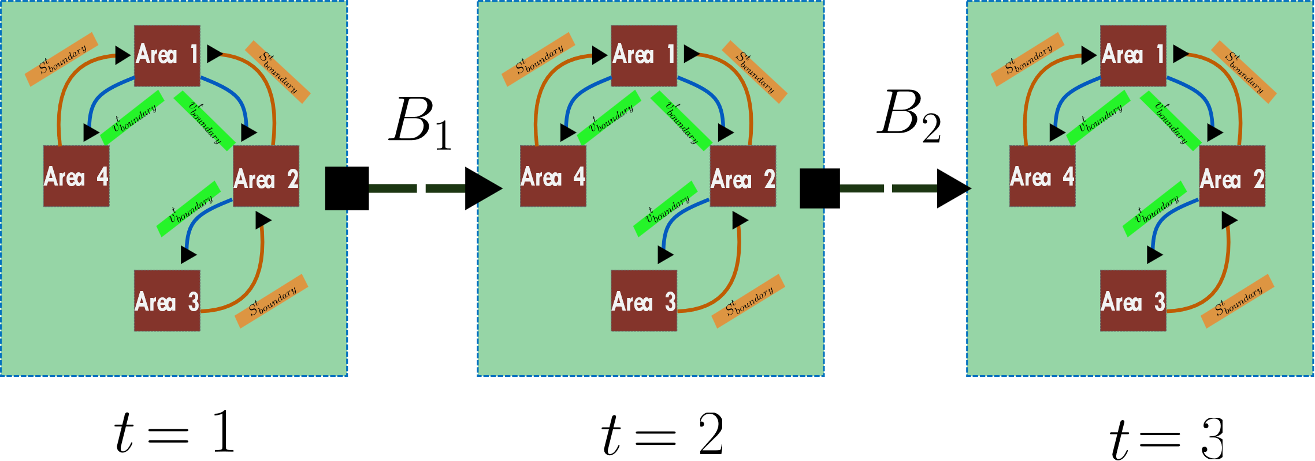
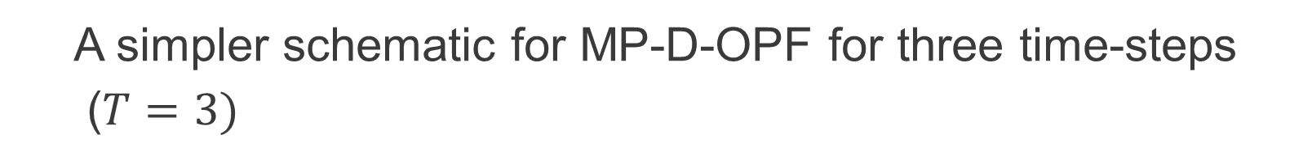
A simpler schematic for MP-D-OPF for three time-steps
($T=3)$

Slide 9
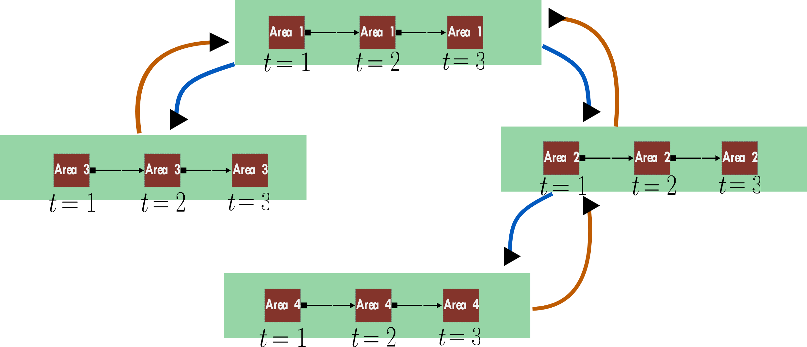
What is currently being done? MP-DOPF in Brute Force

Slide 10
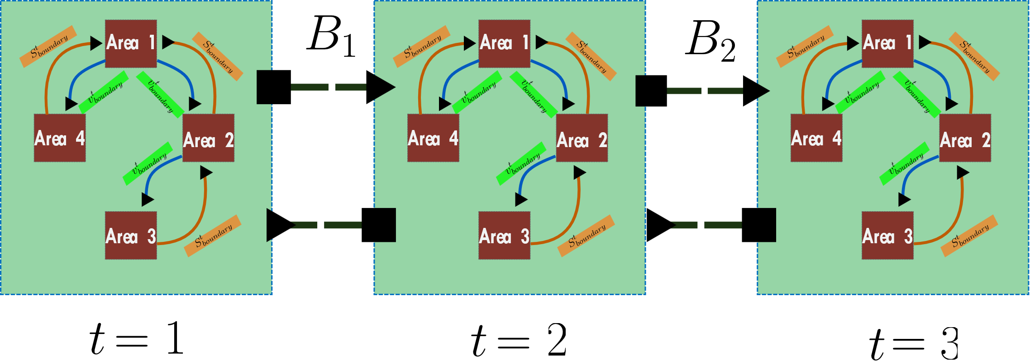
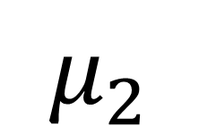
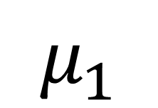
What is will be done? A ‘true’ MP-DOPF using Differential Dynamic Programming (Currently under formulation, variables not explained here) [3]
$$μ_{1}$$
$$μ_{2}$$

Slide 11
Overall Scope of the problem Algorithm and Communication Architecture
OpenDSO-System Operator (Forecast)
OpenDSO-Measurement Devices
OpenDSO-EDO
OpenDSO-OpenDSO

Slide 12
Goal of Avista (problem objective for System Operator)
Problem objective of System Operator: Currently Modelled Use Case: Loss minimization
Use case communicated to all OpenDSO controllers
All OpenDSO controllers procure the models for the respective EDO nodes (the grid edge models: currently we’re modelling these as batteries, but generalized battery model can also be used, but we can make any other model work too which captures flexibility over time.)
Upon getting that, they locally optimize for their area
Then share the boundary information with the neighbouring OpenDSO nodes
Previous two steps are repeated until boundary values are converged.

Slide 13

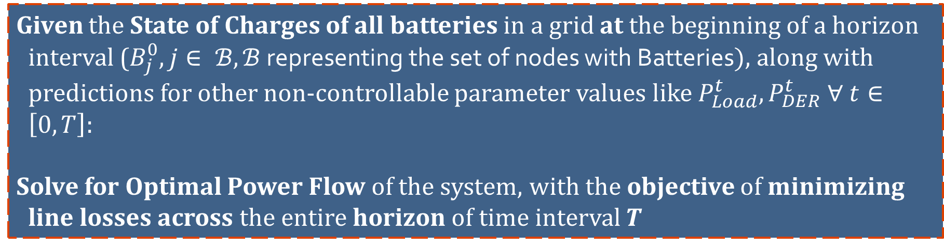
Problem Statement
Given the State of Charges of all batteries in a grid at the beginning of a horizon interval ($B_{j}^{0}, j∈ ℬ, ℬ$ representing the set of nodes with Batteries$)$, along with predictions for other non-controllable parameter values like $P_{Load}^{t}, P_{DER}^{t} ∀ t∈\left[0, T\right]$:
Solve for Optimal Power Flow of the system, with the objective of minimizing line losses across the entire horizon of time interval $T$

Slide 14
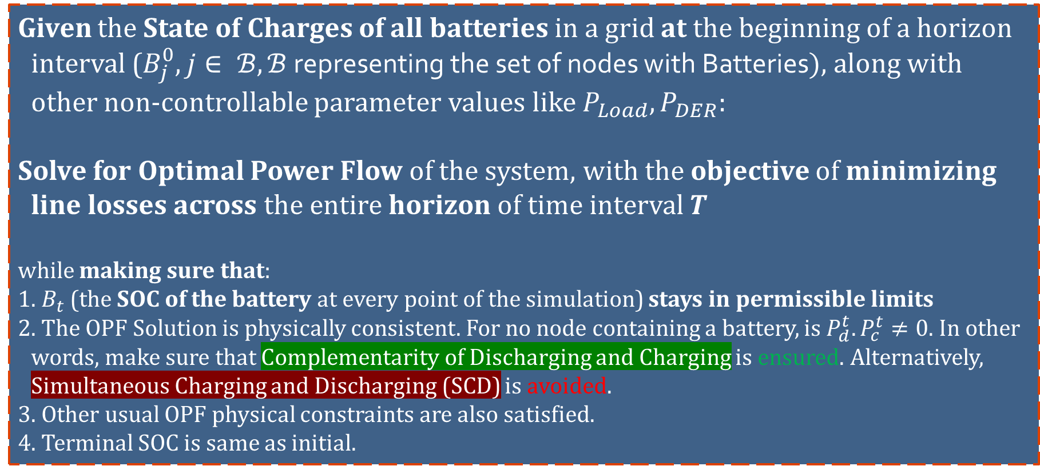
Problem Statement
Given the State of Charges of all batteries in a grid at the beginning of a horizon interval ($B_{j}^{0}, j∈ ℬ, ℬ$ representing the set of nodes with Batteries$)$, along with other non-controllable parameter values like $P_{Load}, P_{DER}$:
Solve for Optimal Power Flow of the system, with the objective of minimizing line losses across the entire horizon of time interval $T$
while making sure that:
1. $B_{t}$ (the SOC of the battery at every point of the simulation) stays in permissible limits
2. The OPF Solution is physically consistent. For no node containing a battery, is $P_{d}^{t}. P_{c}^{t}≠0$. In other words, make sure that Complementarity of Discharging and Charging is ensured. Alternatively, Simultaneous Charging and Discharging (SCD) is avoided.
3. Other usual OPF physical constraints are also satisfied.
4. Terminal SOC is same as initial.

Slide 15
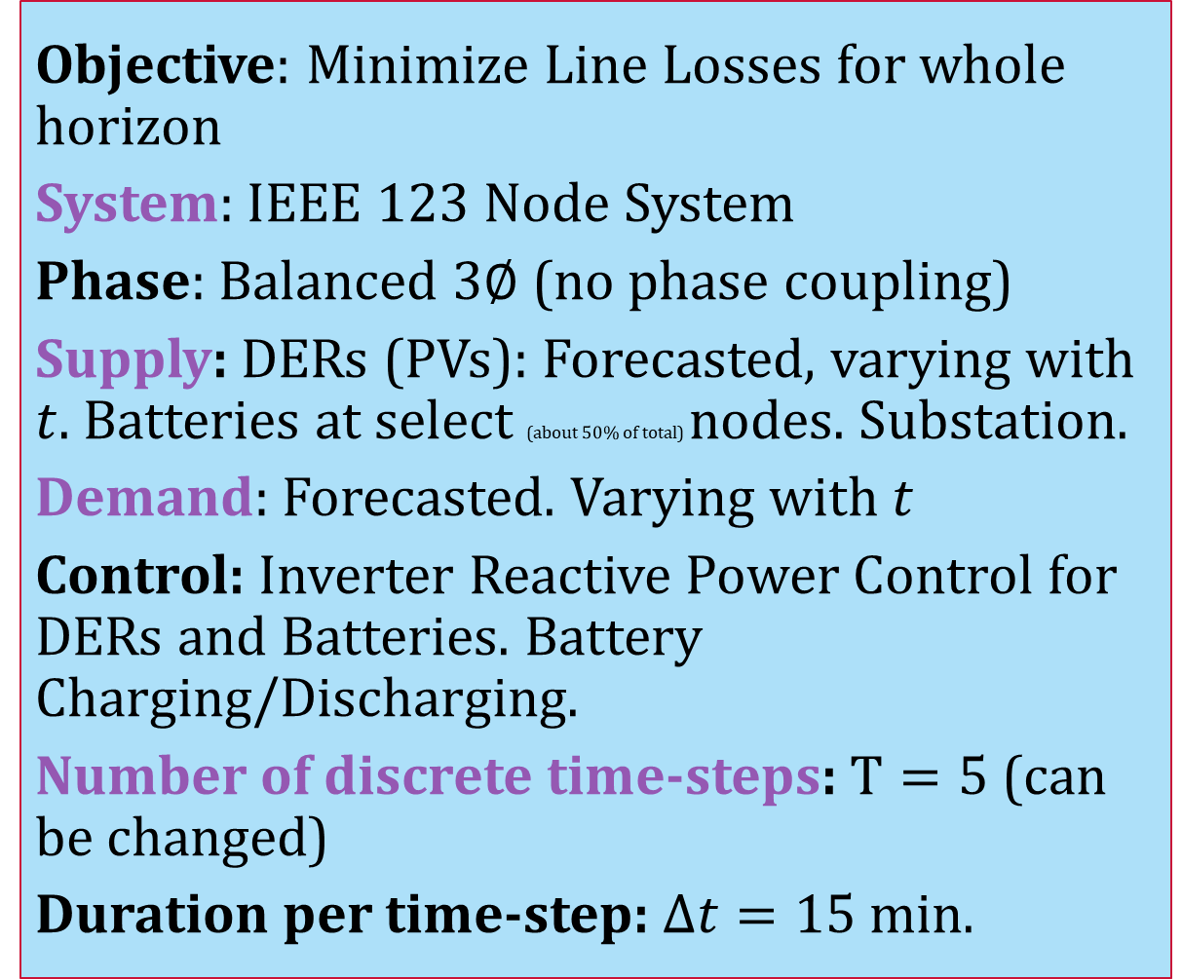
Simulation Parameters
Objective: Minimize Line Losses for whole horizon
System: IEEE $123$ Node System
Phase: Balanced $3∅$ (no phase coupling)
Supply: DERs (PVs): Forecasted, varying with $t$. Batteries at select (about $50\%$ of total) nodes. Substation.
Demand: Forecasted. Varying with $t$
Control: Inverter Reactive Power Control for DERs and Batteries. Battery Charging/Discharging.
Number of discrete time-steps: $T=5$ (can be changed)
Duration per time-step: $Δt=15$min.

Slide 16
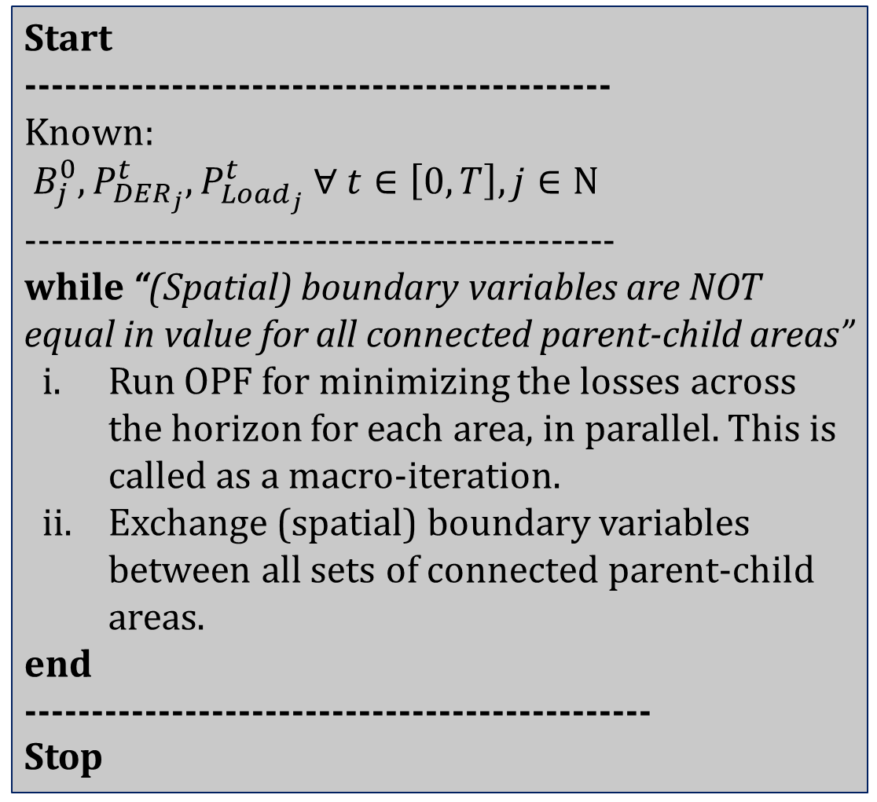
Simulation Process of the current, brute-force algorithm
Start
--------------------------------------------
Known:
$B_{j}^{0}, P_{DER_{j}}^{t}, P_{Load_{j}}^{t} ∀ t∈\left[0, T\right], j∈Ν$
---------------------------------------------
while “(Spatial) boundary variables are NOT equal in value for all connected parent-child areas”
Run OPF for minimizing the losses across the horizon for each area, in parallel. This is called as a macro-iteration.
Exchange (spatial) boundary variables between all sets of connected parent-child areas.
end
-----------------------------------------------
Stop

Slide 17
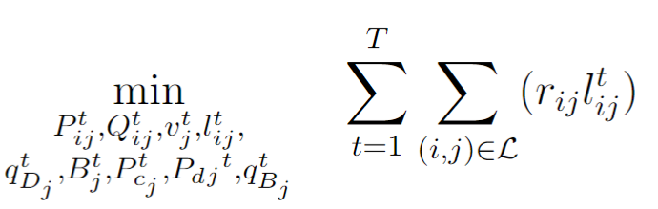
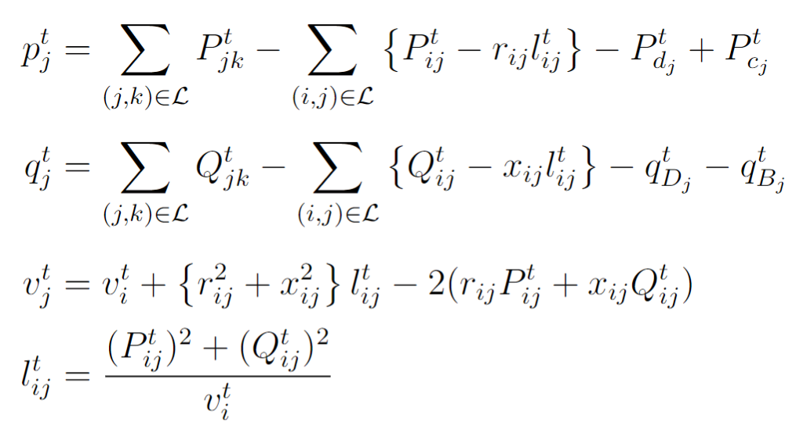
Optimization Formulation
(Integer-Constraint Relaxed) Non-linear Optimization Problem: BFM Constraints with Battery and DER decision variables.
Line Losses
Real Powerflow from a bus into the network
Reactive Powerflow from a bus into the network
Kirchhoff's Voltage Law (KVL)
Current Magnitude in a branch

Slide 18
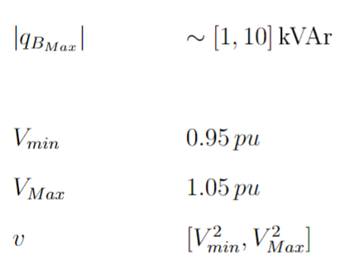
Optimization Formulation
(Integer-Constraint Relaxed) Non-linear Optimization Problem: BFM Constraints with Battery and DER decision variables.
Line Losses
DER Inverter Reactive Power
Nodal Voltage Limits

Slide 19
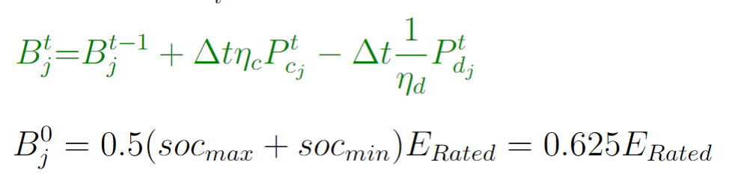
Optimization Formulation
(Integer-Constraint Relaxed) Non-linear Optimization Problem: BFM Constraints with Battery and DER decision variables.
Line Losses
Battery State of Charge Equation (this equation is temporally coupled, or has ‘memory’)

Slide 20
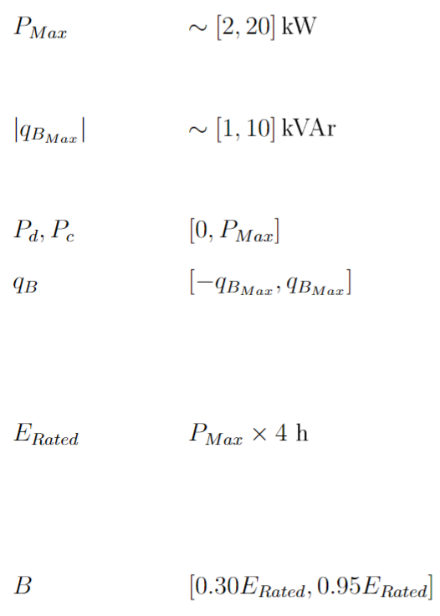
Optimization Formulation
(Integer-Constraint Relaxed) Non-linear Optimization Problem: BFM Constraints with Battery and DER decision variables.
Line Losses
Battery Charging and Discharging Power Limits
Battery Inverter Reactive Power Limits
Battery SOC Permissible Limits

Slide 21
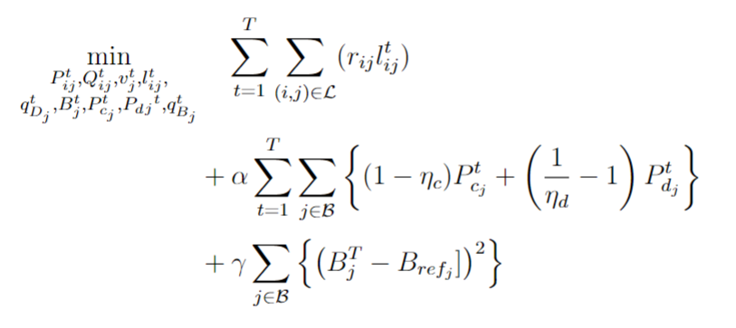
Optimization Formulation
(Integer-Constraint Relaxed) Non-linear Optimization Problem: Tweaking the Objective Function to satisfy some more constraints.
Line Losses
Ensures Complementarity of Charging and Discharging, or alternatively, ensure there’s no SCD.
For minimizing the deviation between end-of-day battery SOC and a reference SOC.

Slide 22
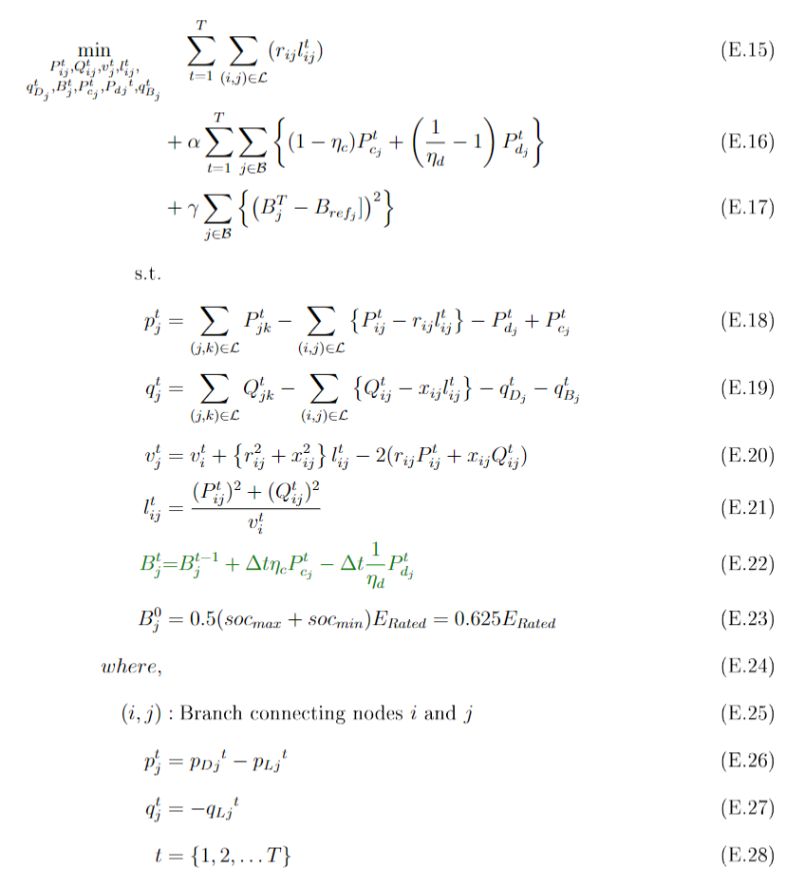
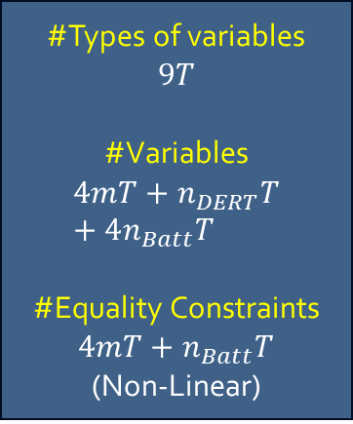
Optimization Formulation
(Integer-Constraint Relaxed) The Full Non-linear Optimization Problem
Line Losses
For minimizing the deviation between end-of-day battery SOC and a reference SOC.
Ensures Complementarity of Charging and Discharging, or alternatively, ensure there’s no SCD.
Real Powerflow from a bus into the network
Battery State of Charge Equation (temporally coupled) with complementarity relaxed.
Reactive Powerflow from a bus into the network
#Types of variables
$$9T$$
#Variables
$$4mT+n_{DERT}T+4n_{Batt}T$$
#Equality Constraints $4mT+n_{Batt}T$
(Non-Linear)
Kirchhoff's Voltage Law (KVL)
Current Magnitude in a branch
DER Generation (forecasted, non-controllable)
Loads (forecasted, non-controllable)

Slide 23
Conclusion and Discussion
Major Observations:
Batteries were modelled correctly, i.e. no Simultaneous Charging and Discharging was observed.
Terminal SOC values (SOC values at end of day) mostly kept close to the original SOC values (beginning of day).
Questions: Currently the EDO Nodes have been modelled as batteries, but different models can be accommodated. What kind of models are Avista expecting?
What kind of objective function is Avista looking to optimize? Currently for line losses, the EDO nodes are operated under direct control, but for price signal inclusion, indirect control can be imposed on the EDO nodes (price signal data will be needed).

Slide 24
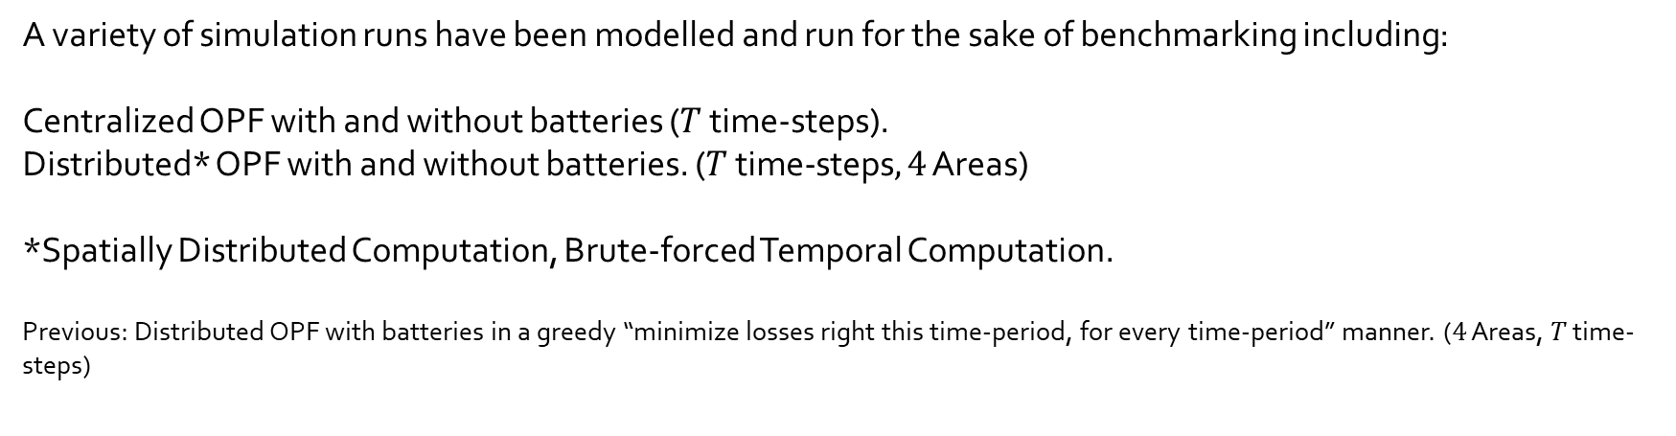
Current Status of Simulation and Results
What has been done
A variety of simulation runs have been modelled and run for the sake of benchmarking including:
Centralized OPF with and without batteries ($T$ time-steps).
Distributed* OPF with and without batteries. ($T \text{time}\text{−}\text{steps}, 4$ Areas)
*Spatially Distributed Computation, Brute-forced Temporal Computation.
Previous: Distributed OPF with batteries in a greedy “minimize losses right this time-period, for every time-period” manner. ($4$ Areas, $T$ time-steps)

Slide 25
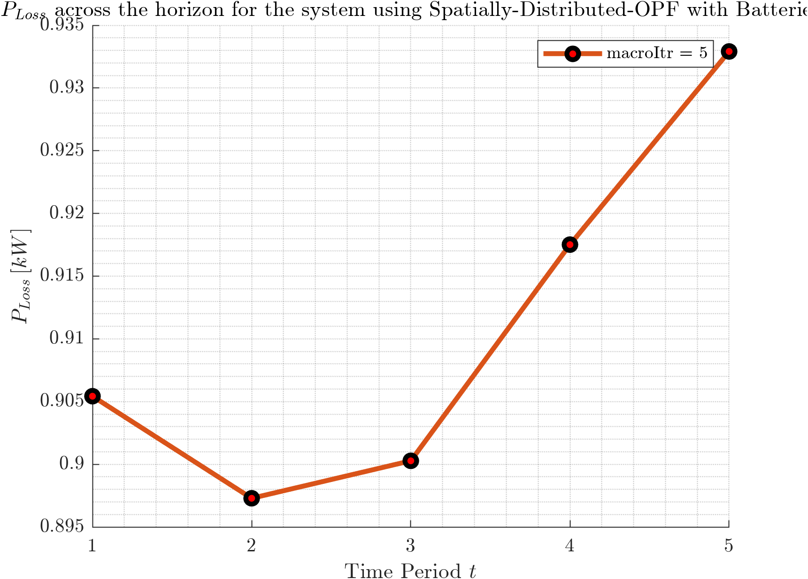
Results: Boundary Variables
$P_{Losses}$vs $t$

Slide 26
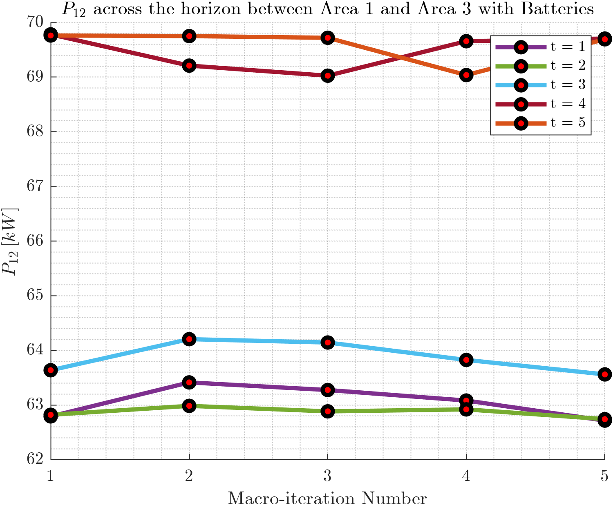
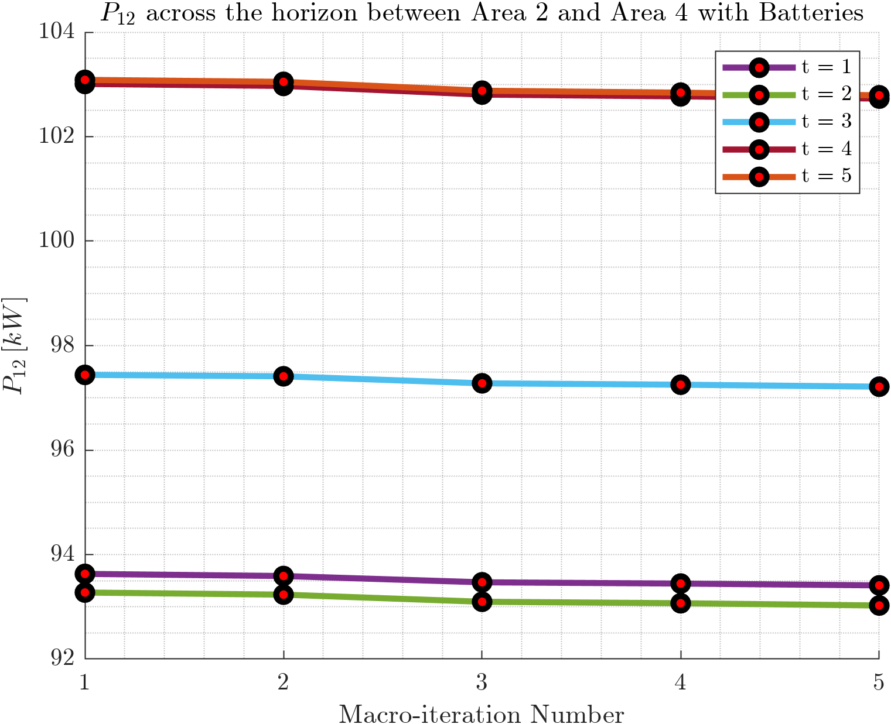
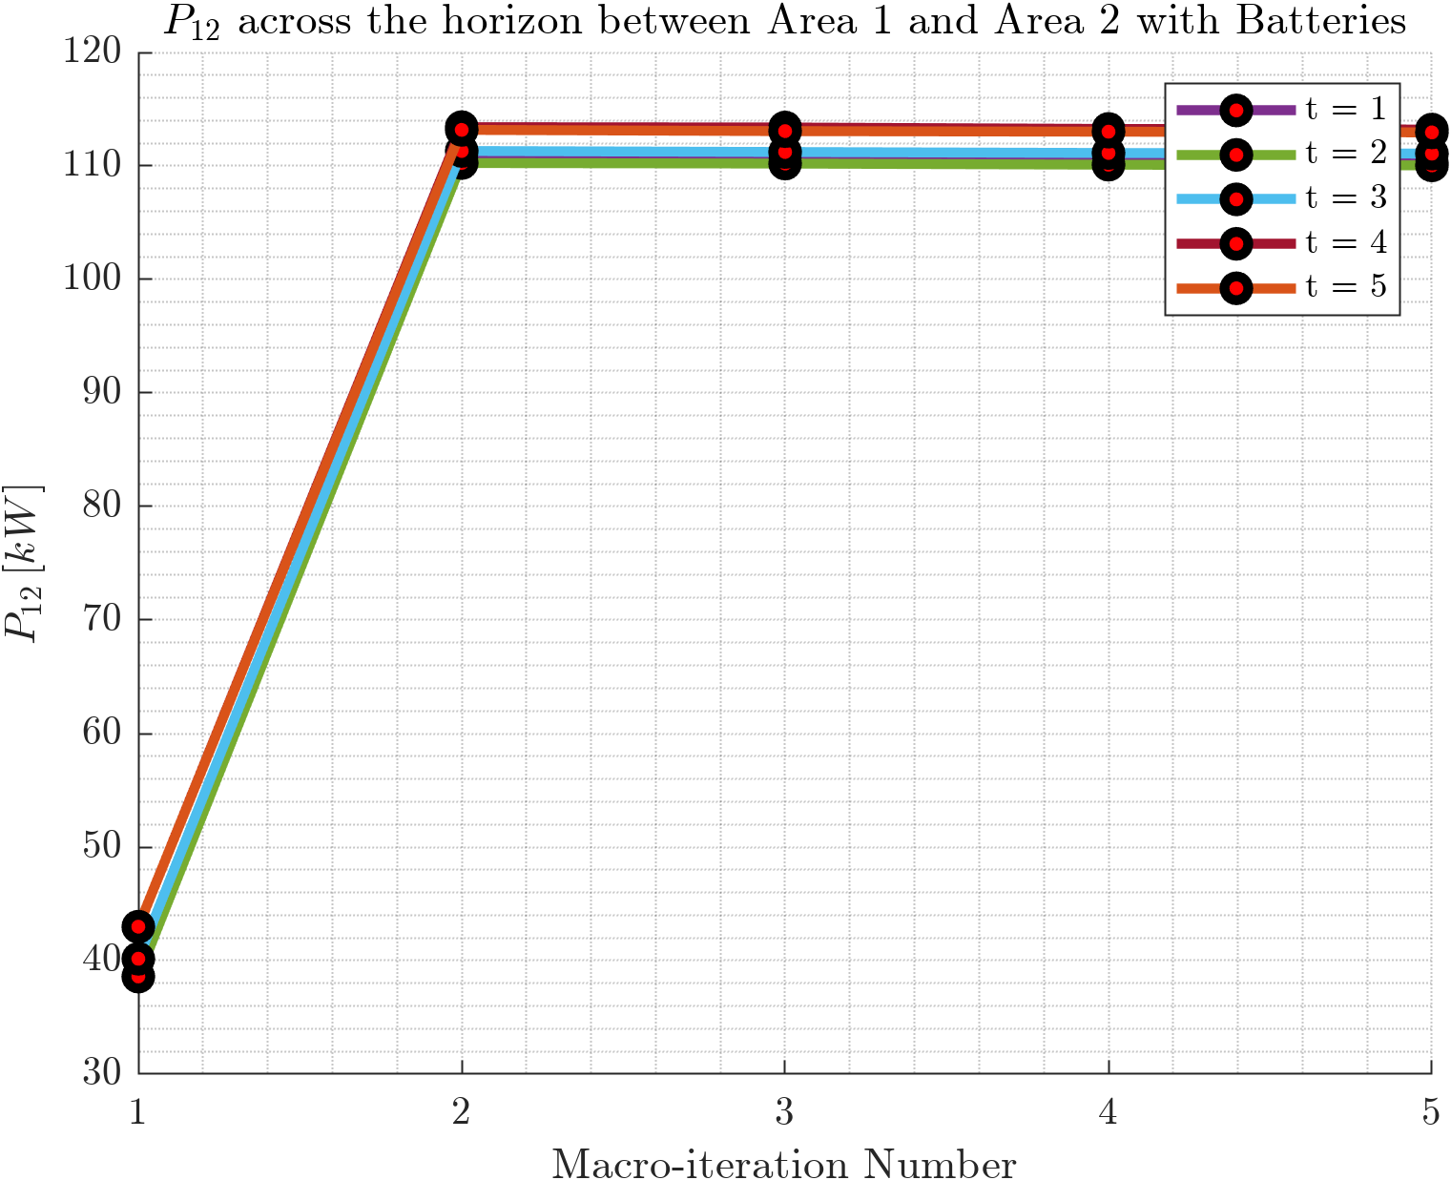
Results: Boundary Variables
$P_{12}$vs $t$

Slide 27
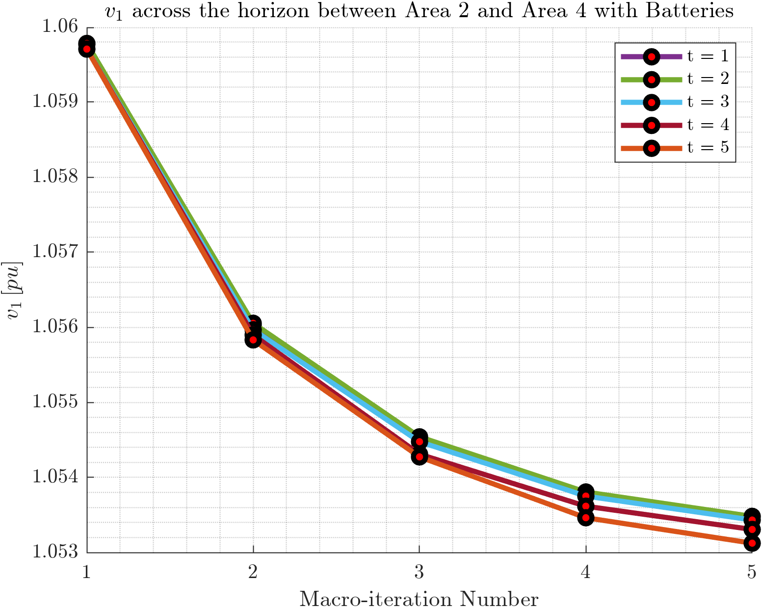
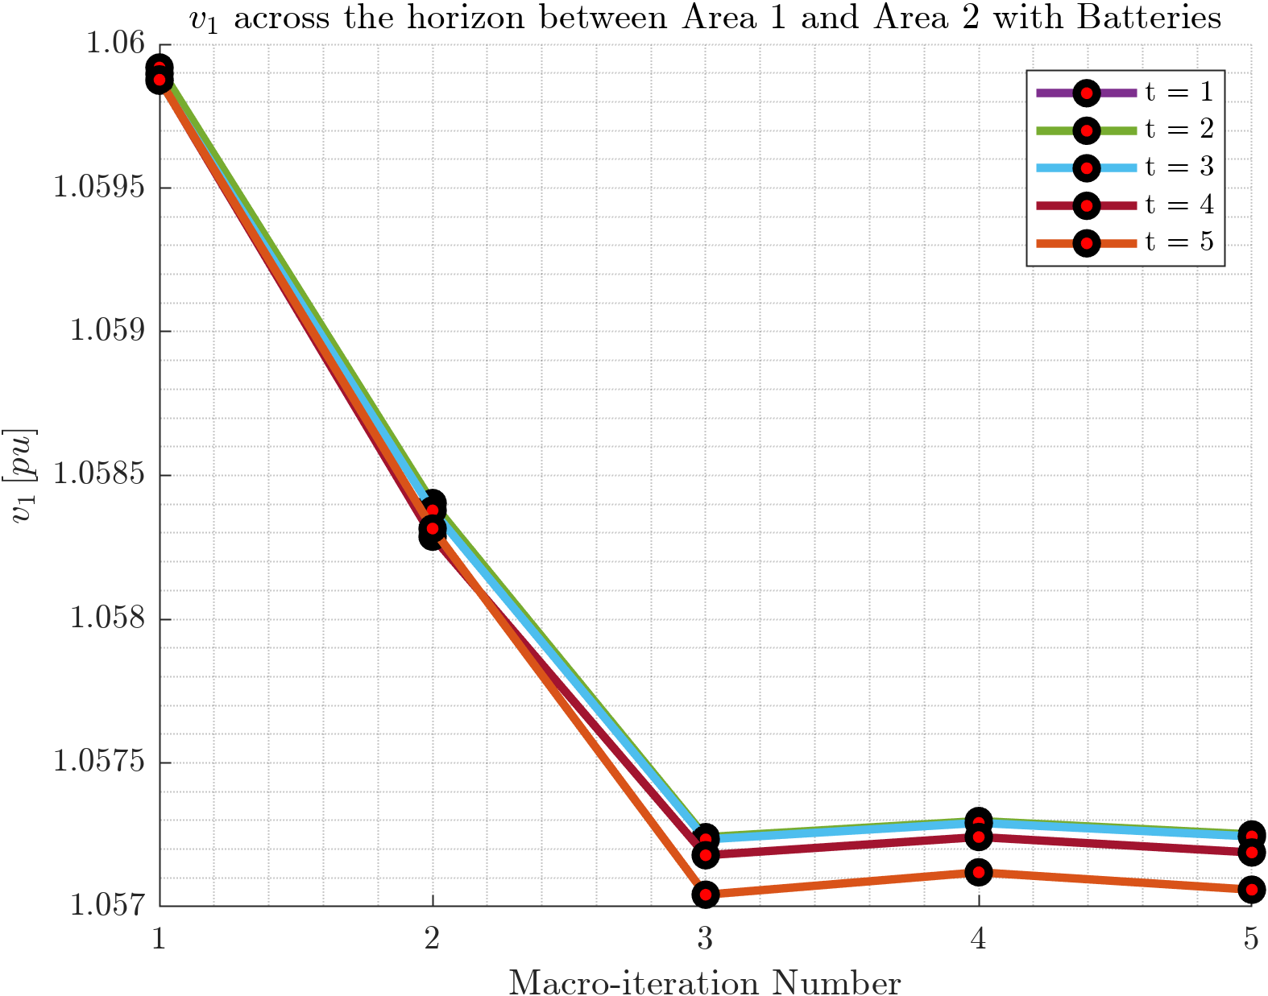
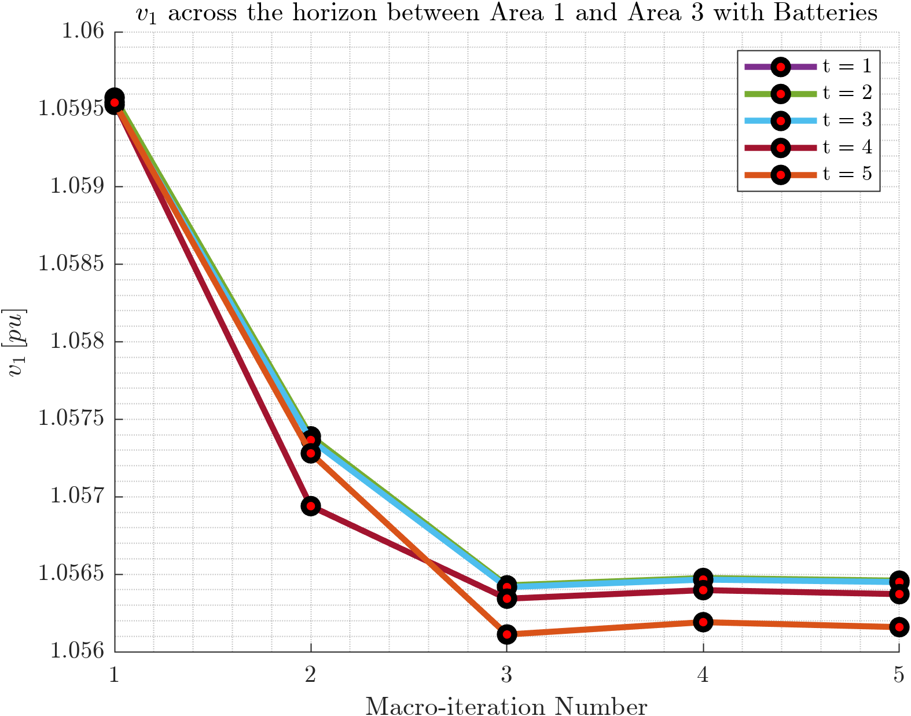
Results: Boundary Variables
$V_{1}$ vs $t$

Slide 28
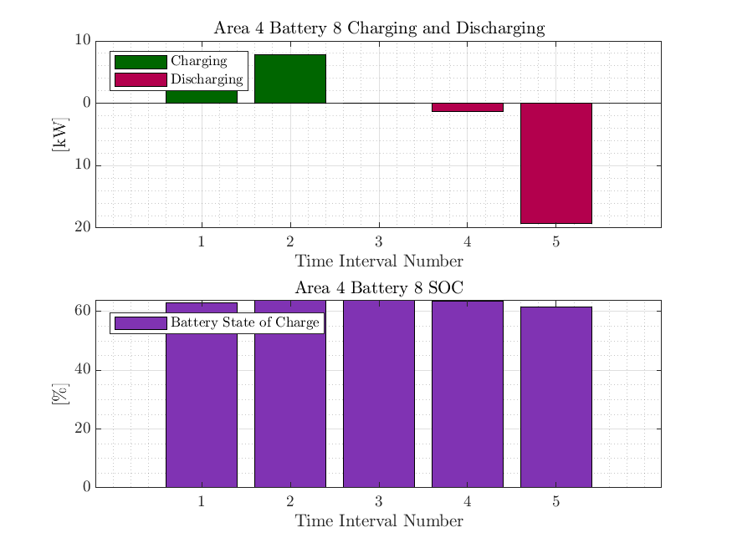
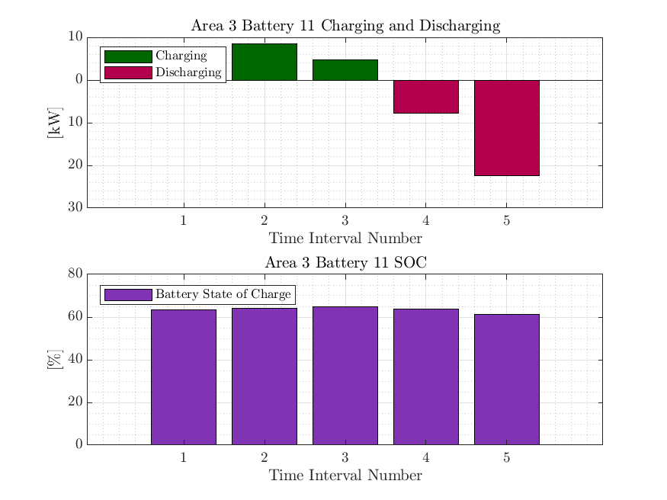
Current Status of Simulation and Results
SCD Plots to check Physical validity of Distributed MPOPF
This simulation was done for 5 time-steps (but the algorithm is scalable, and I’ve done them for 10, 15 time-steps. But the time taken by the brute force algorithm grows exponentially with number of time steps)
Charging and Discharging are always Complementary.
Terminal SOC is almost the same as initial SOC

Slide 29
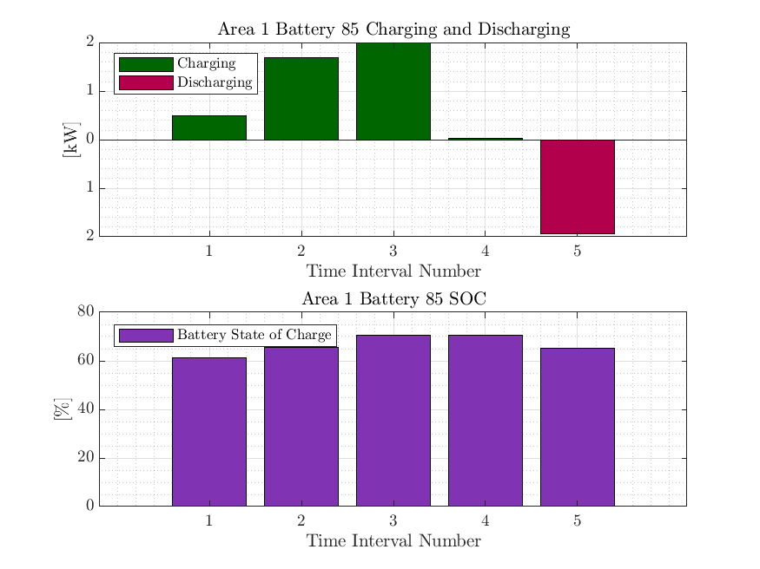
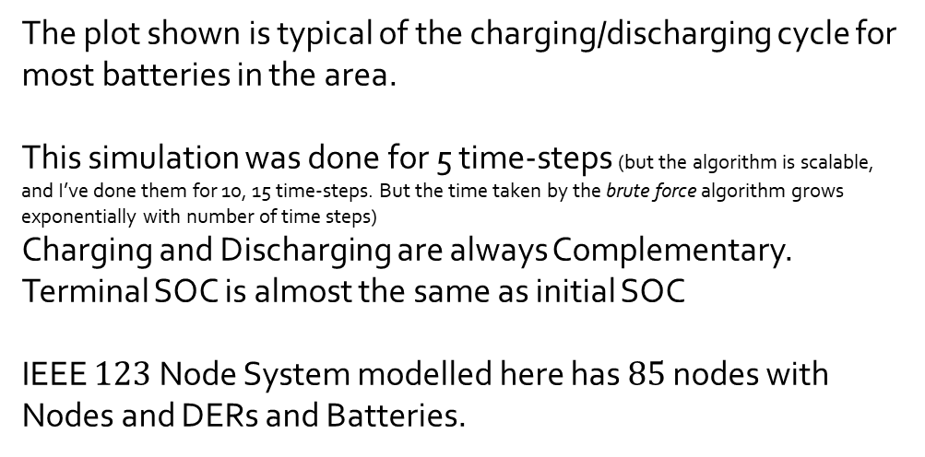
Current Status of Simulation and Results
Results for $123$ Node System from Centralized MPOPF
The plot shown is typical of the charging/discharging cycle for most batteries in the area.
This simulation was done for 5 time-steps (but the algorithm is scalable, and I’ve done them for 10, 15 time-steps. But the time taken by the brute force algorithm grows exponentially with number of time steps)
Charging and Discharging are always Complementary.
Terminal SOC is almost the same as initial SOC
IEEE $123$ Node System modelled here has $85$ nodes with Nodes and DERs and Batteries.

Slide 30
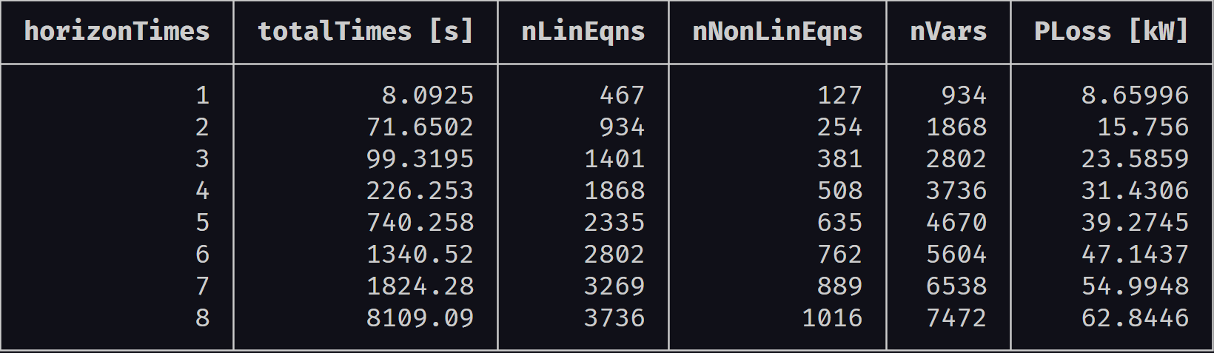
Current Status of Simulation and Results
Results for $123$ Node System from Centralized MPOPF

Slide 31
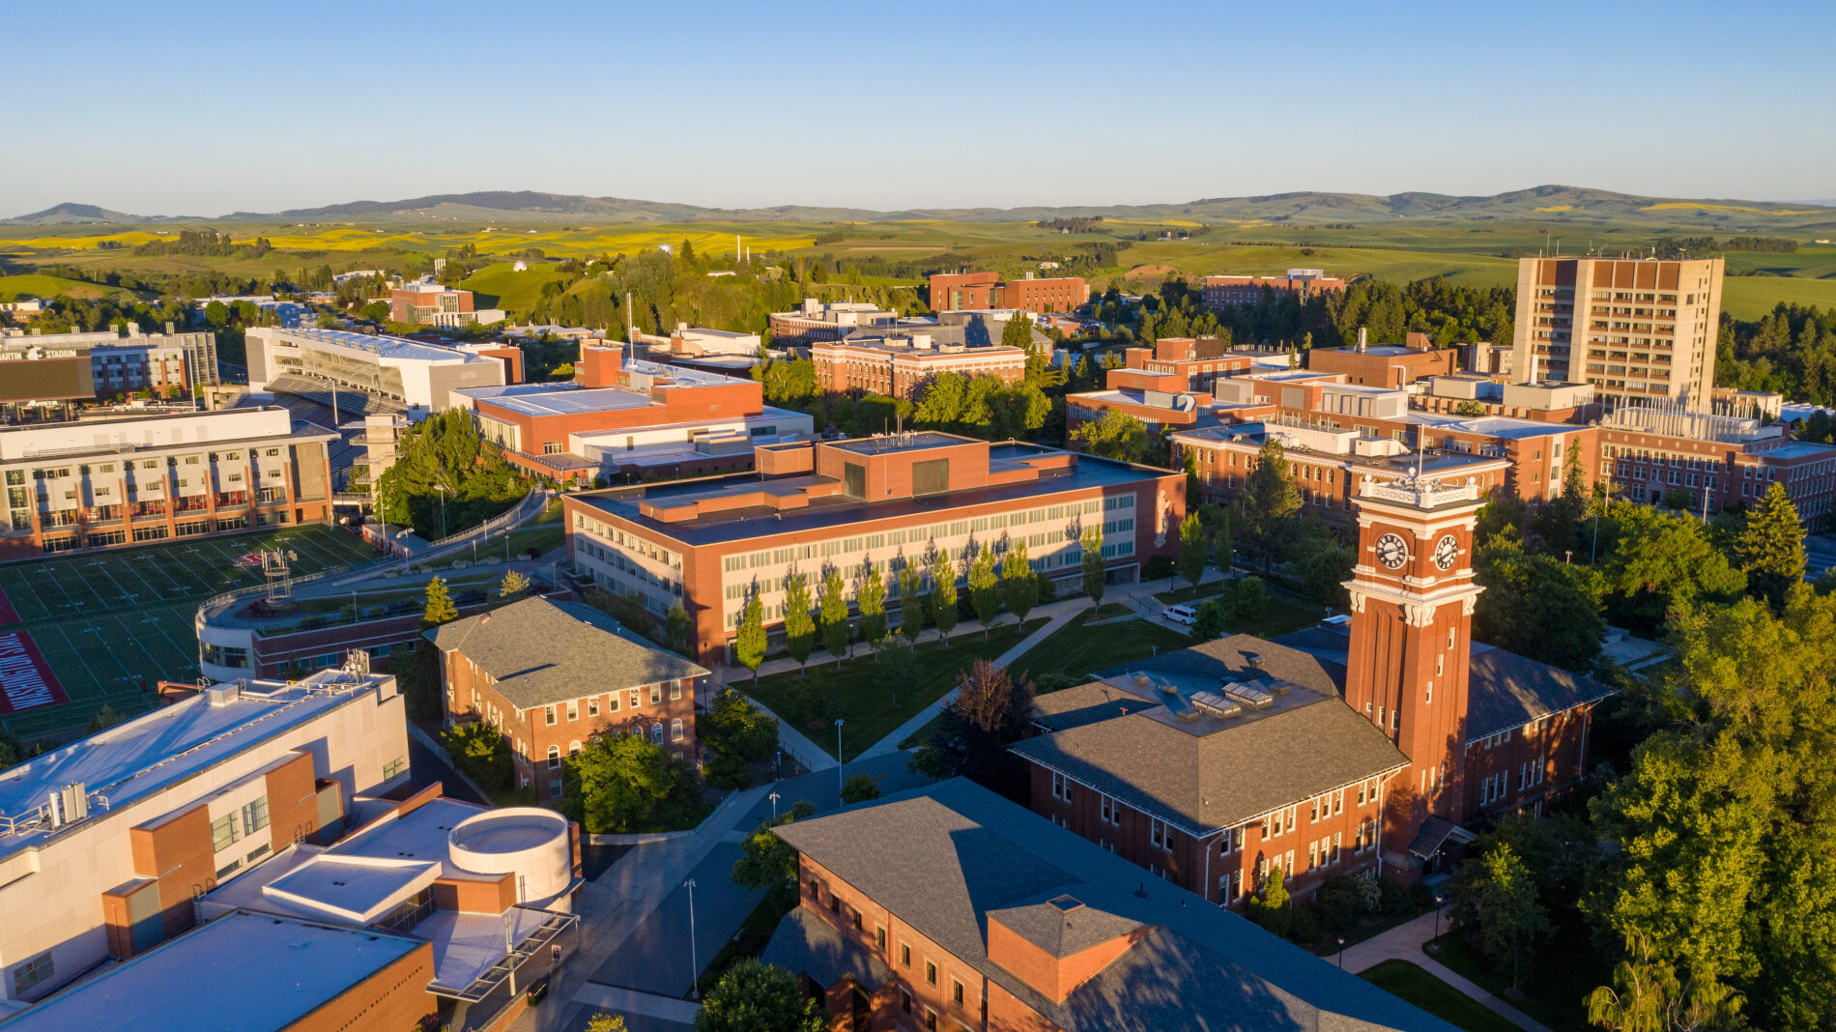
Thank You.

Slide 32
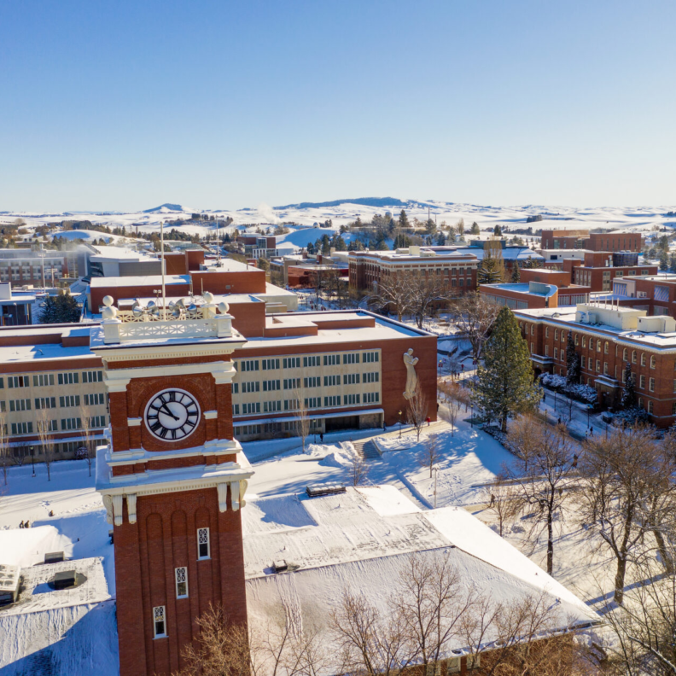
Appendix and References follow

Slide 33
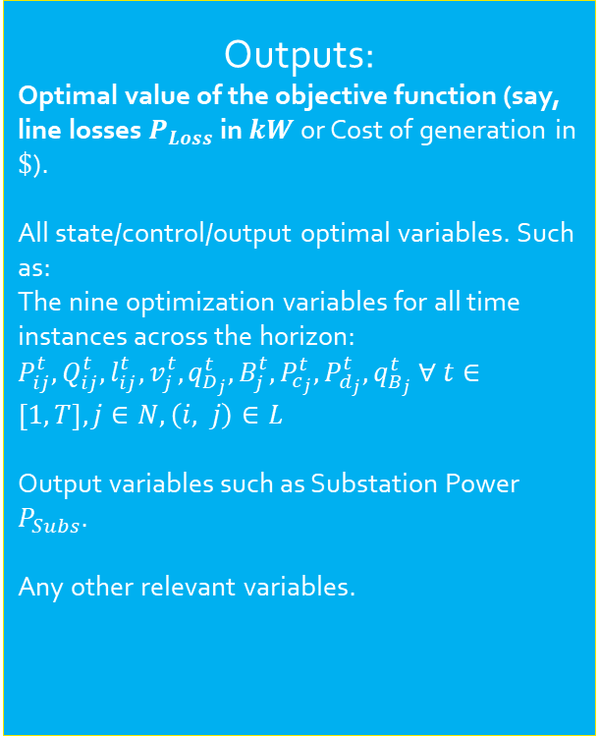
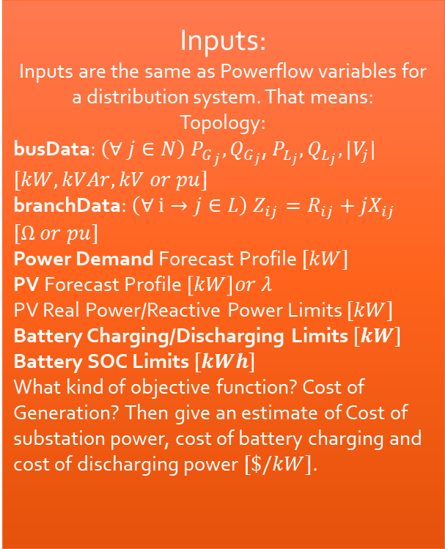
Implementation Details
Platform, Input, Output
Platform:
Current Implementation is in MATLAB.
Model: Multi-Period Non-Linear OPF
Inputs:
Inputs are the same as Powerflow variables for a distribution system. That means: Topology:
busData: $\left(∀ j∈N\right) {P_{G}}_{j}, Q_{G_{j}}$, $P_{L_{j}}, Q_{L_{j}}, {|V}_{j}|$ $[kW, kVAr, kV or pu]$
branchData: $\left(∀ i→j∈L\right) Z_{ij}=R_{ij}+jX_{ij}$ $[Ω or pu]$
Power Demand Forecast Profile $[kW]$
PV Forecast Profile $\left[kW\right]or λ$
PV Real Power/Reactive Power Limits $[kW]$
Battery Charging/Discharging Limits $[kW]$
Battery SOC Limits $[kWh]$
What kind of objective function? Cost of Generation? Then give an estimate of Cost of substation power, cost of battery charging and cost of discharging power $[\$/kW]$.
Outputs:
Optimal value of the objective function (say, line losses $P_{Loss}$ in $kW$ or Cost of generation in $\$$).
All state/control/output optimal variables. Such as: The nine optimization variables for all time instances across the horizon: $P_{ij}^{t}, Q_{ij}^{t}, l_{ij}^{t}, v_{j}^{t}, q_{D_{j}}^{t}, B_{j}^{t}, P_{c_{j}}^{t}, P_{d_{j}}^{t}, q_{B_{j}}^{t} ∀ t∈\left[1, T\right], j∈N, \left(i, j\right)∈L$
Output variables such as Substation Power $P_{Subs}$.
Any other relevant variables.
Information needed to be exchanged between EDO Nodes and my area optimization controller. (depends on objective function)
Communication among OpenDSO nodes.

Slide 34
Implementation Details
Optimization Algorithm Needs
Inputs: Data needs for Topology
Branch
To Node, From Node, RX
Bus
Controllable
Base PQ
Static Load PQ
Allocation Factor
Devices
Discover Buses and Branches for Section that it is optimizing
Discover List of Upstream Neighbors and Downstream Neighbors
Subscribe to their Parameters

Slide 35
Implementation Details
Optimization Algorithm Needs
Inputs: Data needs from In Zone Devices
Cap Bank
Status
Simple Expected Behavior
Discussion: Need to establish a method to correlate measurements and model with expected controls actions.
Regulator
Tap Position
Simple Expected Behavior
Discussion: Need to establish a method to correlate measurements and model with expected controls actions.
Other Measurement Devices Data Needs
For Static Load Calibration
Solution Feedback

Slide 36
Implementation Details
Optimization Algorithm Needs
Inputs: Data needs from Neighbor Algorithm Agents on OpenDSO
Power Flow
V,I,P,Q
Algorithm Specific Coordination Parameters
To be determined in algorithm system design
Convergence Indication
Speed of communication for iterative algorithm convergence
Asynchronous vs Synchronous
To be determined in algorithm system design

Slide 37
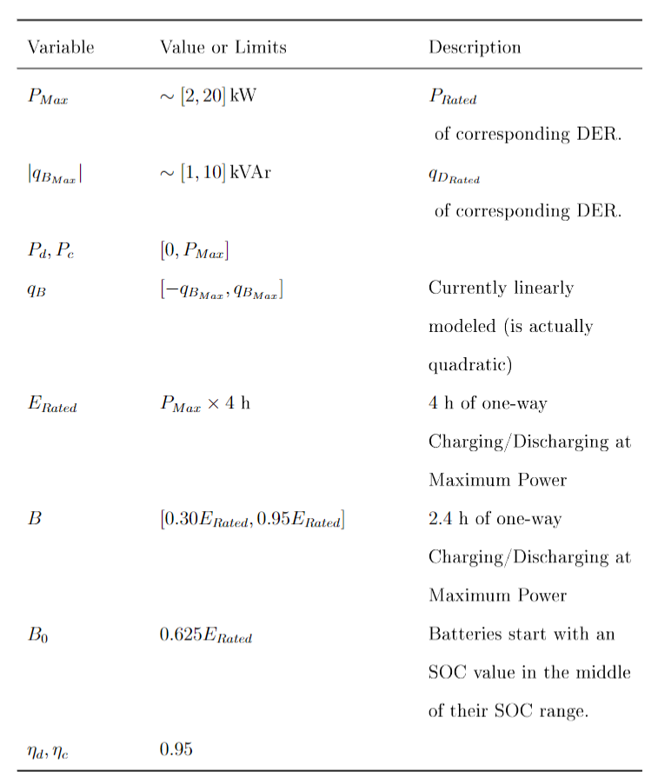
Bounds and Values
Battery State/Control Variables (1/2)

Slide 38
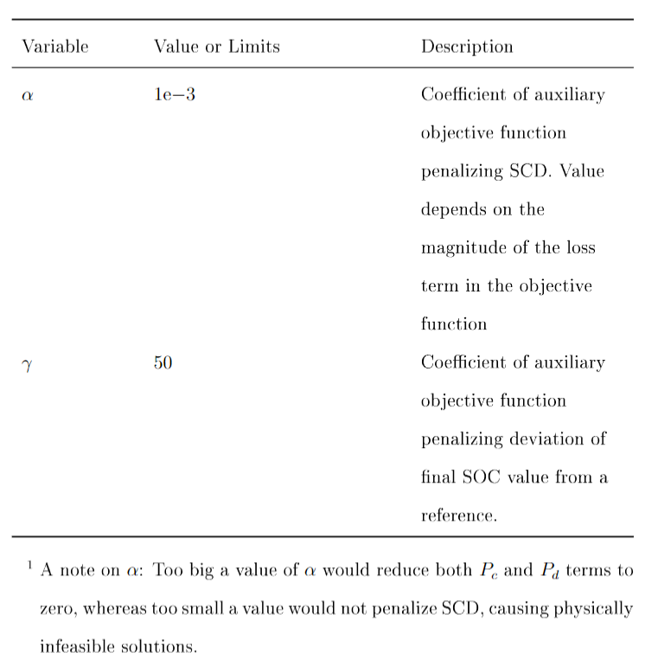
Bounds and Values
Battery State/Control Variables (2/2)

Slide 39
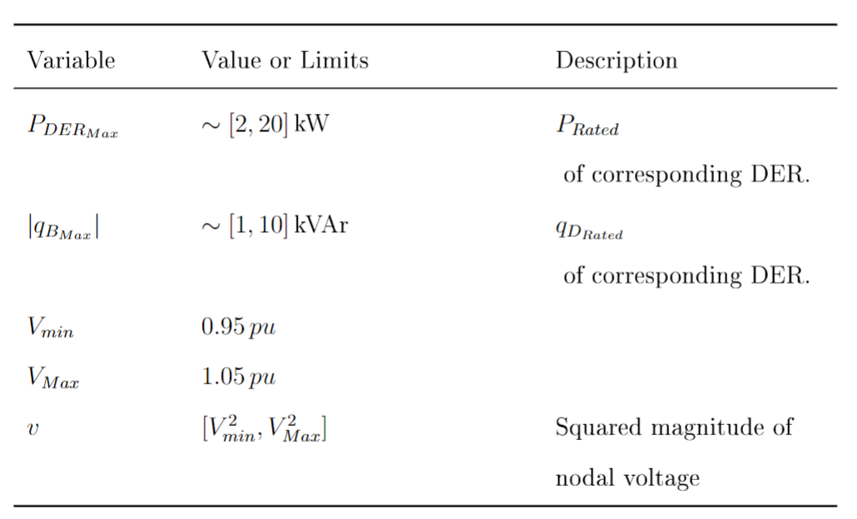
Bounds and Values
BFM and DER State/Control Variables

Slide 40
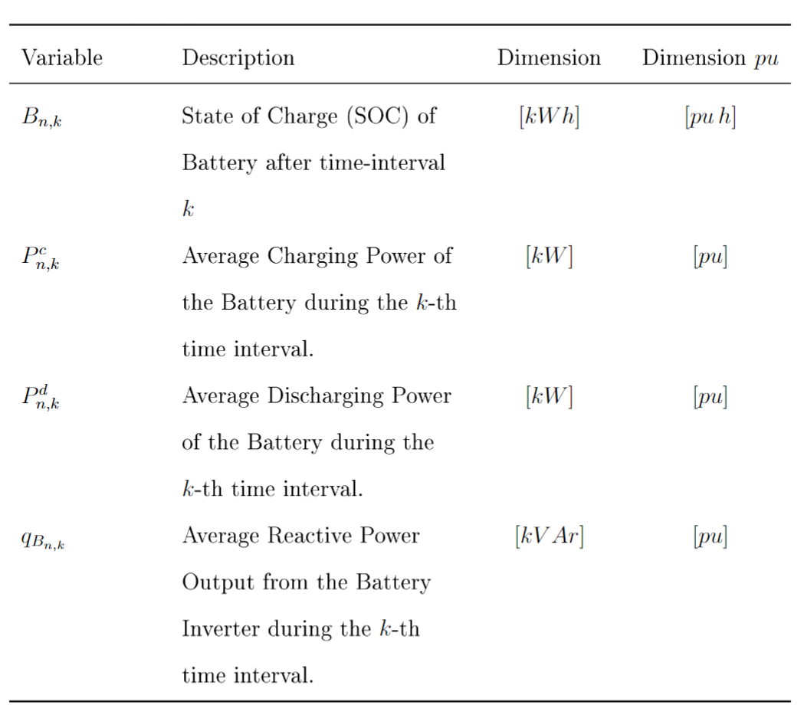
Reference of Notation: Battery Variables

Slide 41
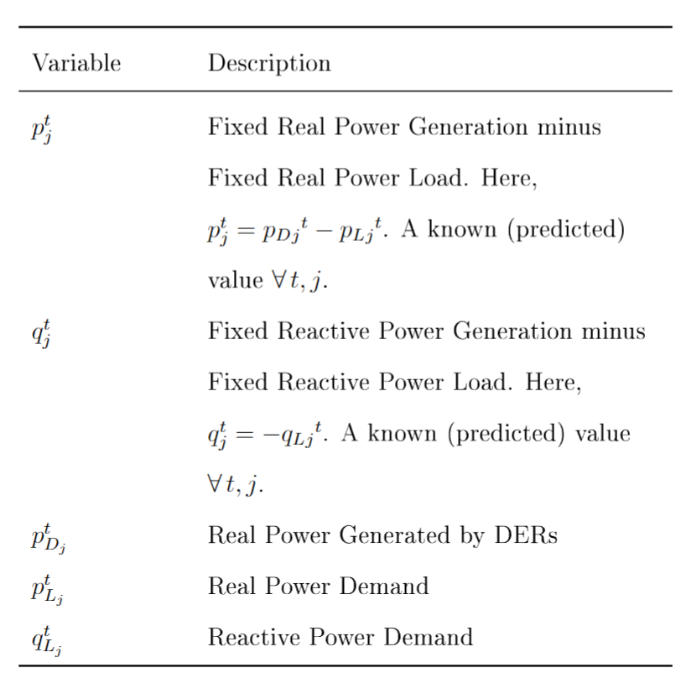
Reference of Notation: BFM and DER Variables

Slide 42
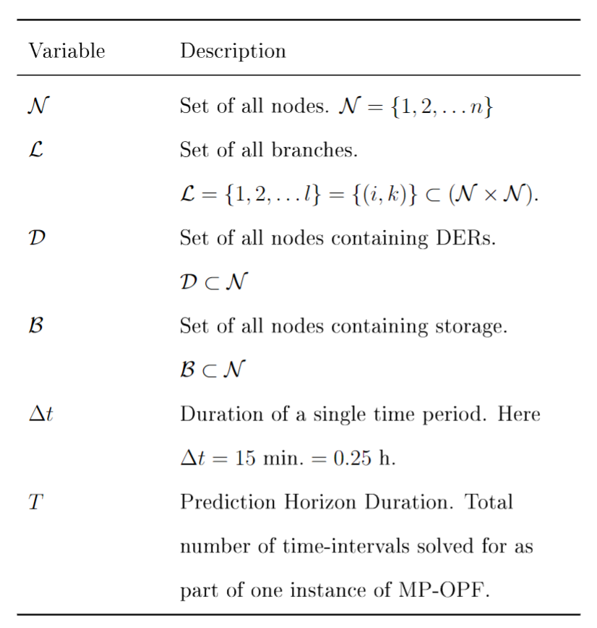
Reference of Notation: Grid-level Notation
Helpful for clarifying any variable in the optimization formulations.

Slide 43

Reference of Notation: Branch Flow Model and DER variables
Helpful for clarifying any variable in the optimization formulations.

Slide 44




(IEEE 123 System divided into) 4 Area System

Slide 45

[In development] Simulation Process of Spatially and Temporally Decomposed OPF algorithm.
Start
------------------------------------------------------------------------
Known:
$B_{j}^{0}, P_{DER_{j}}^{t}, P_{Load_{j}}^{t} ∀ t∈\left[0, T\right], j∈Ν$
-----------------------------------------------------------------------
while “temporal boundary variables are NOT equal in value for all consecutive time intervals”
while “spatial boundary variables are NOT equal in value for all connected parent-child areas”
Run (D-)OPF for minimizing the losses across the horizon for each area, in parallel. This is called as a macro-iteration.
Exchange spatial boundary variables between all sets of connected parent-child areas.
end
Exchange temporal boundary variables between consecutive time intervals
end
------------------------------------------------------------------------
Stop

Slide 46

Optimization Formulation
Mixed-Integer Non-linear Optimization Problem (in built-complementarity, but harder to solve)
Line Losses
Battery State of Charge Equation (this equation is temporally coupled, or has ‘memory’)
Real Powerflow from a bus into the network
Reactive Powerflow from a bus into the network
Kirchhoff's Voltage Law (KVL)
Current Magnitude in a branch
Complementarity of Charging and Discharging during a particular time interval.
DER Generation (forecasted, non-controllable)
Loads (forecasted, non-controllable)

Slide 47
References
[1] Sadnan, R., & Dubey, A. (2021). Distributed Optimization Using Reduced Network Equivalents for Radial Power Distribution Systems. IEEE Trans. Power Syst., 36(4), 3645–3656. doi: 10.1109/TPWRS.2020.3049135
[2] Eilyan Bitar's Papers. (2023, August 16). Coordinated Aggregation
of Distributed Demand-Side Resources. Retrieved from https://bitar.engineering.cornell.edu/papers.html
[3] Pandey, A., Agarwal, A., & Pileggi, L. (2020). Incremental Model Building Homotopy Approach for Solving Exact AC-Constrained Optimal Power Flow. arXiv, 2011.00587. Retrieved from https://arxiv.org/abs/2011.00587v1

